Slide 1
Analyzing the Impact of Demographic and Economic Factors on COVID-19 Outcomes:
A Comparative Analysis of
USA and Global Trends in Cases and Deaths
Max Li
UCLA Extension - COM SCI X 450.2 (Winter 2023)
Exploratory Data Analysis and Visualization (March 16th, 2023)

Slide 2
Table of Contents
Introduction
Research Question
Data Set and Source
Data Cleaning
Summary Statistics
Results and Findings
Conclusions
Future steps
References

Slide 3
Introduction
2022.Apr
Present with COVID-19
The situation continues to evolve as new variants emerge and governments implement measures to control the spread of the virus. The development of new treatments and vaccines for COVID-19 remains a priority
2021.Oct
Omicron Variant Emerged & Widespread
Coronavirus disease (COVID-19): an infectious disease caused by the SARS-CoV-2 virus
Although most people infected with the virus will experience mild to moderate respiratory illness and recover without requiring special treatment, Older people and those with underlying medical conditions like cardiovascular disease, diabetes, chronic respiratory disease, or cancer are more likely to become seriously ill and require medical attention.
The Omicron variant of the virus is identified, leading to concern about its increased transmissibility and potential for vaccine evasion.
2021.Jan
Variants Emerge & Vaccination Starts
The number of cases and deaths continues to decrease in some countries, but variants of the virus emerge and spread rapidly in others. Vaccination campaigns begin in many countries.
2020. Mar
WHO Declaration of COVID-19 Pandemic
Governments around the world begin implementing measures such as social distancing, travel restrictions, and lockdowns to slow the spread of the virus.
COVID-19 Cases | 681,965,905
COVID-19 Deaths | 6,814,875
Unemployment (2020) | 144 Millions
2019.Dec
First Outbreak of COVID-19 in China
Cases of a mysterious respiratory illness are reported in Wuhan, China. The cause is later identified as a new strain of coronavirus, officially named SARS-CoV-2.
Source [1][2]

Slide 4
II. Research Questions
Questions: How do demographic and economic factors impact on COVID-19 outcomes or what is the relationship between demographic/economic factors and COVID-19 outcomes
Purpose: To examine the relationship between demographic/economic factors such as age, gender, income, health status and GDP per capita and COVID-19 outcomes including cases, deaths, vaccination and reproduction rates in the USA and worldwide. By examining these factors, the project aims to identify patterns and correlations that can inform public health policies and interventions to mitigate the impact of the COVID-19 pandemic.

Slide 5
III. Data Set and Source
1st Data Set: COVID-19 in major continents and countries (except Antarctica) from the outbreak of disease to the Feb-27, 2023
Data set comes from: Kaggle (https://www.kaggle.com/datasets/sandhyakrishnan02/latest-covid-19-dataset-worldwide)
Data Source: Based on the Nature Scientific Data article, Hasell, J., Mathieu, E., Beltekian, D. et al. A cross-country database of COVID-19 testing. Sci Data 7, 345 (2020) and which continues to be updated, can be downloaded from a public GitHub repository (https://github.com/owid/covid-19-data/tree/master/public/data/testing)
2nd Data Set: total confirmed cases of COVID-19 per million people depending on their location and their GDP per capita in 2017
Data set comes from: Our World in Data (https://ourworldindata.org/coronavirus)
Data Source: World Health Organization (WHO), which updates its dataset weekly (up to 2023-02-28)
Notes:
4 data in total, 4 of them from different sources

Slide 6
III. Data Set and Source
3rd Data Set: COVID-19 related illnesses and deaths with their certain group and also provides deaths by Pneumonia and Influenza within the United States
Data set comes from: Center for Disease Control and Prevention (CDC) (https://data.cdc.gov/NCHS/Provisional-COVID-19-Deaths-by-Sex-and-Age/9bhg-hcku)
Data Source: National Center for Health Statistics (NCHS)
4th Data Set: Average Temperature of States in the USA by Date
Data set comes from: National Oceanic and Atmospheric Administration (NOAA) National Centers for Environmental information, Climate at a Glance: Statewide Time Series (https://www.ncei.noaa.gov/access/monitoring/climate-at-a-glance/statewide/time-series)
Data Source: U.S. Climate Divisional Database, which have data from 1895 to the present

Slide 7
IV. Data Cleaning
1st Data Set: owid-covid-data.csv
Filtering out unnecessary column and rows
year: Convert date in form of MM/DD/YYYY to year
season: Create a season column using imported library "hydroTSM" and its function time2season
Replace NA to 0 as all NA columns was data point per each day
2nd Data Set: total-confirmed-cases-of-covid-19-permillion-people-vs-gdp-per-capita.csv
Entity: Change Column Name into Location
Filtering out unnecessary column and rows
Code: Change name into iso_code
year: Change name into Year and 2020, 2021, 2022, 2023
Seasons: Create a Seasons column using “Day” (character) column and group it by Seasons
Dec - Feb : Winter, March - May: Spring, Jun - Aug: Summer, Sep-Nov: Autumn
GDP per Capita: Gross domestic product at purchasing power parity (constant 2011 international dollars), calculate GDP mean of the allocated time period

Slide 8
IV. Data Cleaning
3rd Data Set: Provisional_COVID-19_Deaths_by_Sex_and_Age.csv
Remove Footnote column
Put all NAs into 0 and do not remove any values
4th Data Set: 2020-2023_Temp_state.csv
No NAs or empty string for all 3 variables
Merged with the 3rd after selecting States within the USA mainland + Alaska

Slide 9
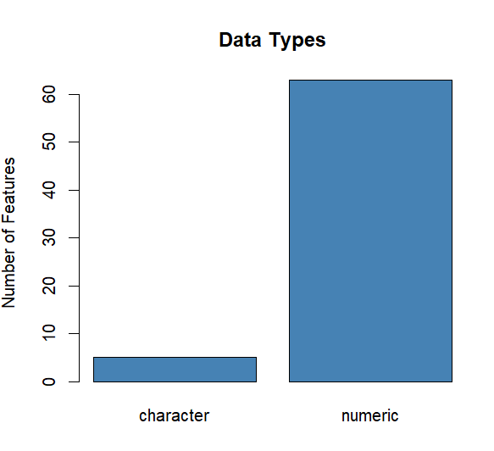
V. Summary Statistics - 1st Data Set
COVID-19 Outcomes, Health Risks and GDP per capita (2021) Worldwide
260567 observations of 67 variables, and numeric variables are the majority
Important Variables from the 1st data set:
continent: Name of the continent to which the country belongs
location: Name of the country
season: Season of every entry
total_cases: Number of allocated positive cases
total_deaths: Total number of COVID-19 deaths
total_vaccinatons: Total number of vaccination
reproduction_rate: measurement of the transmissibility of infectious agents (COVID-19)
GDP per capita : GDP per capita (2021)

Slide 10
V. Summary Statistics: 2nd Data Set
COVID-19 Cases with GDP per Capita (2017) Worldwide
Dataset Features | Numbers
Observations | 246,505
Total Variables | 8
Character Variables | 4
Numerical Variables | 4
Important variables from the 2nd dataset:
Entity: Name of the country
Year: Year of data entry
Day: Date of every entry
Total confirmed cases of COVID-19 per million people
Continent
GDP: GDP per capita, PPP (constant 2017 international $)

Slide 11
V. Summary Statistics: 3rd Data Set
COVID-19 Deaths with other diseases by Demographic factors in the USA
Dataset Features | Numbers
Observations | 118,422
Total Variables | 15
Character Variables | 7
Numerical Variables | 8
Important variables from the 3rd dataset:
Sex: Gender of the person.
State: State which this event happened.
Age Group: Selection a group of people around the same age.
COVID-19 Deaths : People who died from Covid-19.

Slide 12
V. Summary Statistics: 4th Data Set
Average Temperature of States in the USA by Date
Important Variables from the 4th dataset:
Date : integer variable with format of YYMM (e.g. 2001 for 2020.Jan) from 2020. January to 2023. January
Avg. Temp. F. : Average Temperature of a State per Month
StateName: Name of the States in the USA
Dataset Features | Numbers
Observations | 1850
Total Variables | 3
Character Variables | 1
Numerical Variables | 2

Slide 13
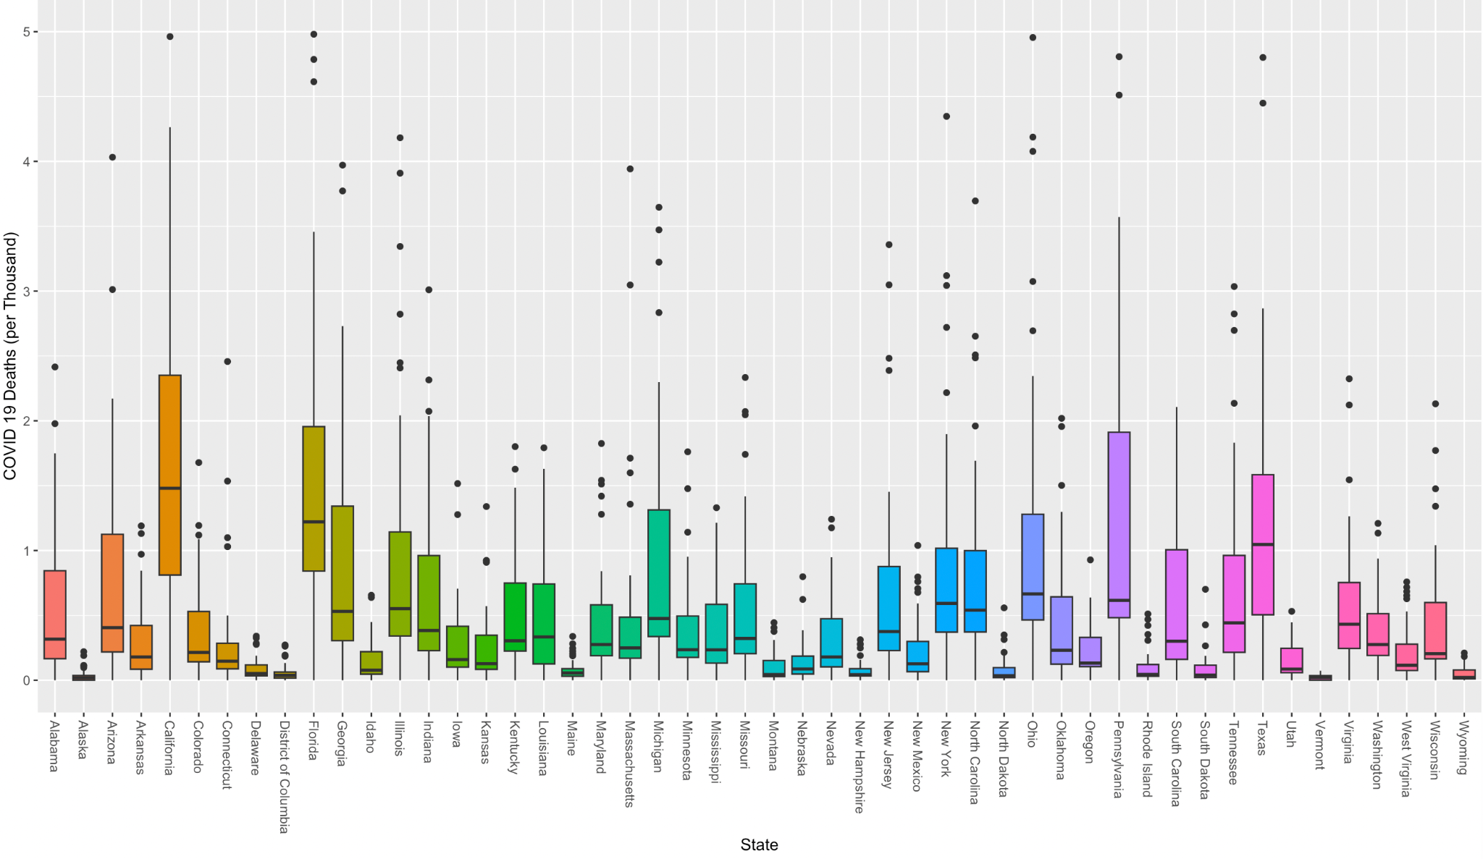
VI. Results and Findings:
Number of Deaths due to COVID-19 by States in the USA including Alaska
Notes:
The boxplot shows the number of Deaths of COVID-19 only less than or equal to 5,000 (Data Points that are Higher than 5,000 Deaths were removed for visualization of the data)
States with smaller population show less number of death in COVID-19 (e.g. Alaska, Vermont, Wyoming)
States with higher population experience higher number of death in COVID-19 (e.g. California, Florida, Pennsylvania, Texas)

Slide 14
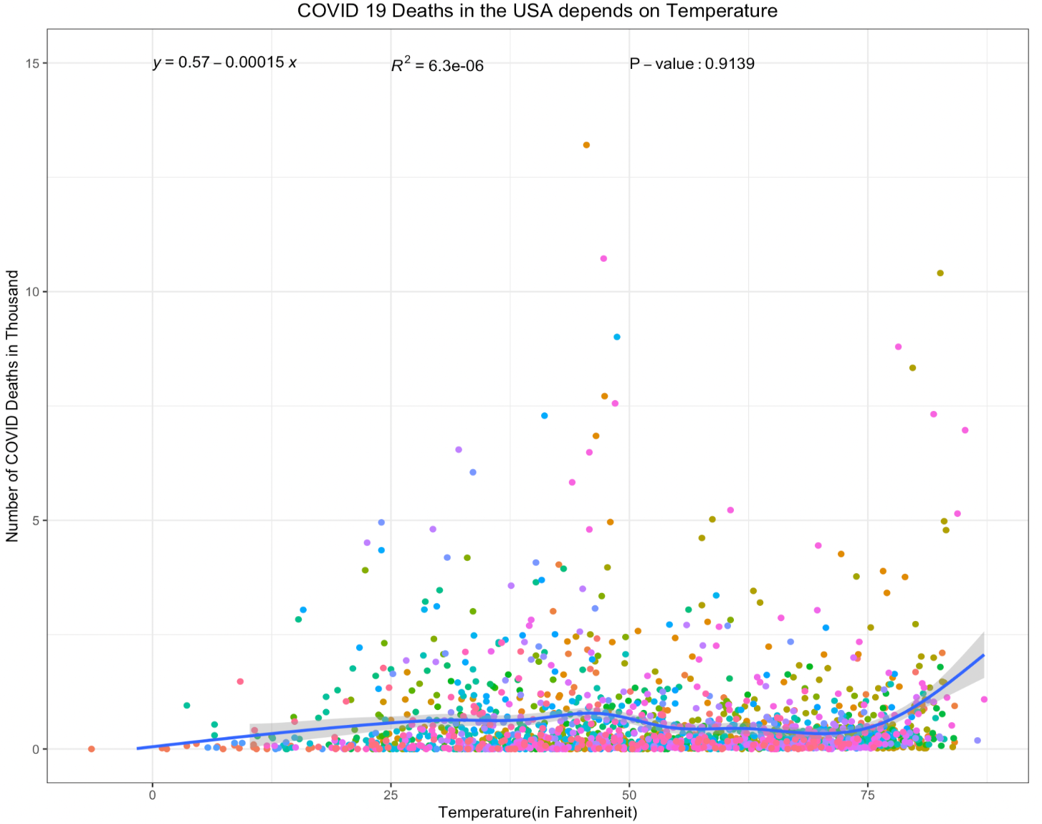
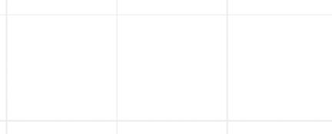
VI. Results and Findings:
Relationship between COVID-19 Deaths & Temperature in the USA
According to the WHO: The COVID-19 virus can spread in hot and humid climates
Assumption: Lower temperature leads to lower movement among population would have less infection and less deaths
Results: The graph shows the tendency of increasing the number of deaths as the temperature increases. However, not highly correlated or significant relationship between temperature and deaths
Notes:
The each color shows a state within USA mainland including Alaska.
The regression line method is called GAM or Generalized additive models with integrated smoothness estimation. It is similar to General Linear Model but with a curve line
Then please says the text in the slide

Slide 15
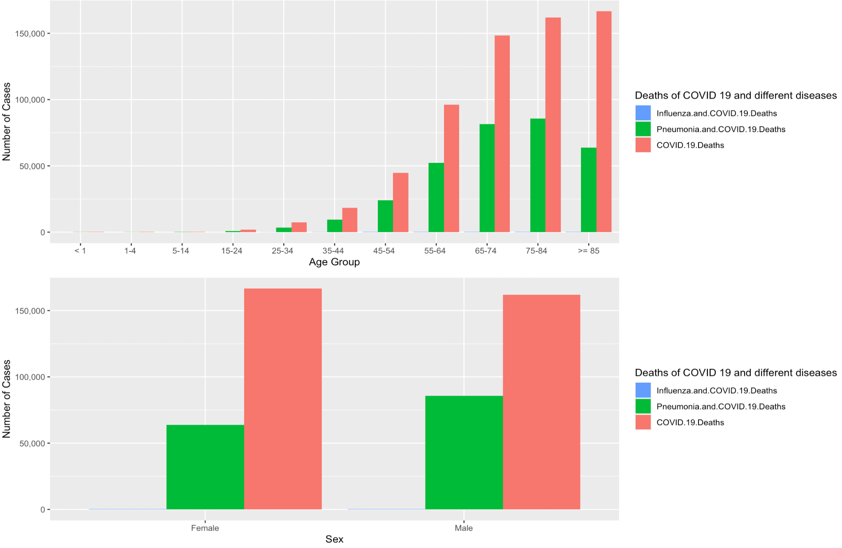
VI. Results and Findings:
COVID-19 Deaths with different diseases in the USA
Deaths caused by COVID-19 was outnumbered than other deaths caused by 2 other diseases
Having Influenza(flu) and COVID-19 at the same time caused the least deaths in the USA among 3 groups
As the number of deaths with having Pneumonia and COVID-19 was greater than that with Influenza and COVID-19, it shows that the function of lung is critical to the people who go through COVID-19
As Ages getting older, higher number of deaths in COVID-19 and other disease
More Female died due to COVID-19 only while more Male died due to both Pneumonia and COVID-19

Slide 16
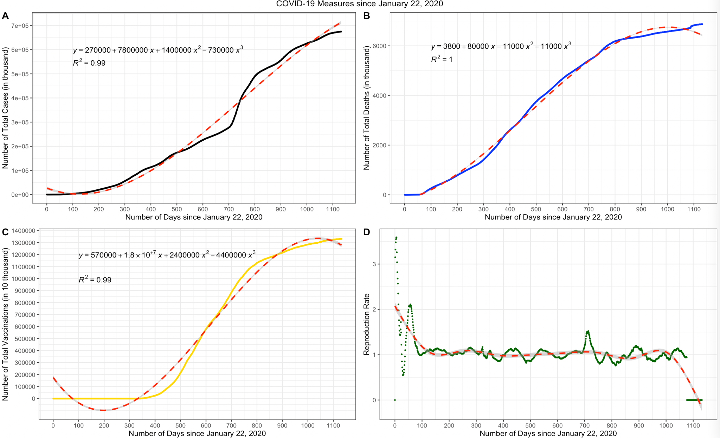
VI. Results and Findings:
Worldwide COVID-19 Outcomes
COVID-19 Cases and Deaths shows Logarithmic Growth as Reproduction rate was very high at the beginning of the COVID-19 outbreak but decreased and stabilized after WHO declares the Pandemic
COVID-19 Vaccination rate also shows Logarithmic Growth

Slide 17
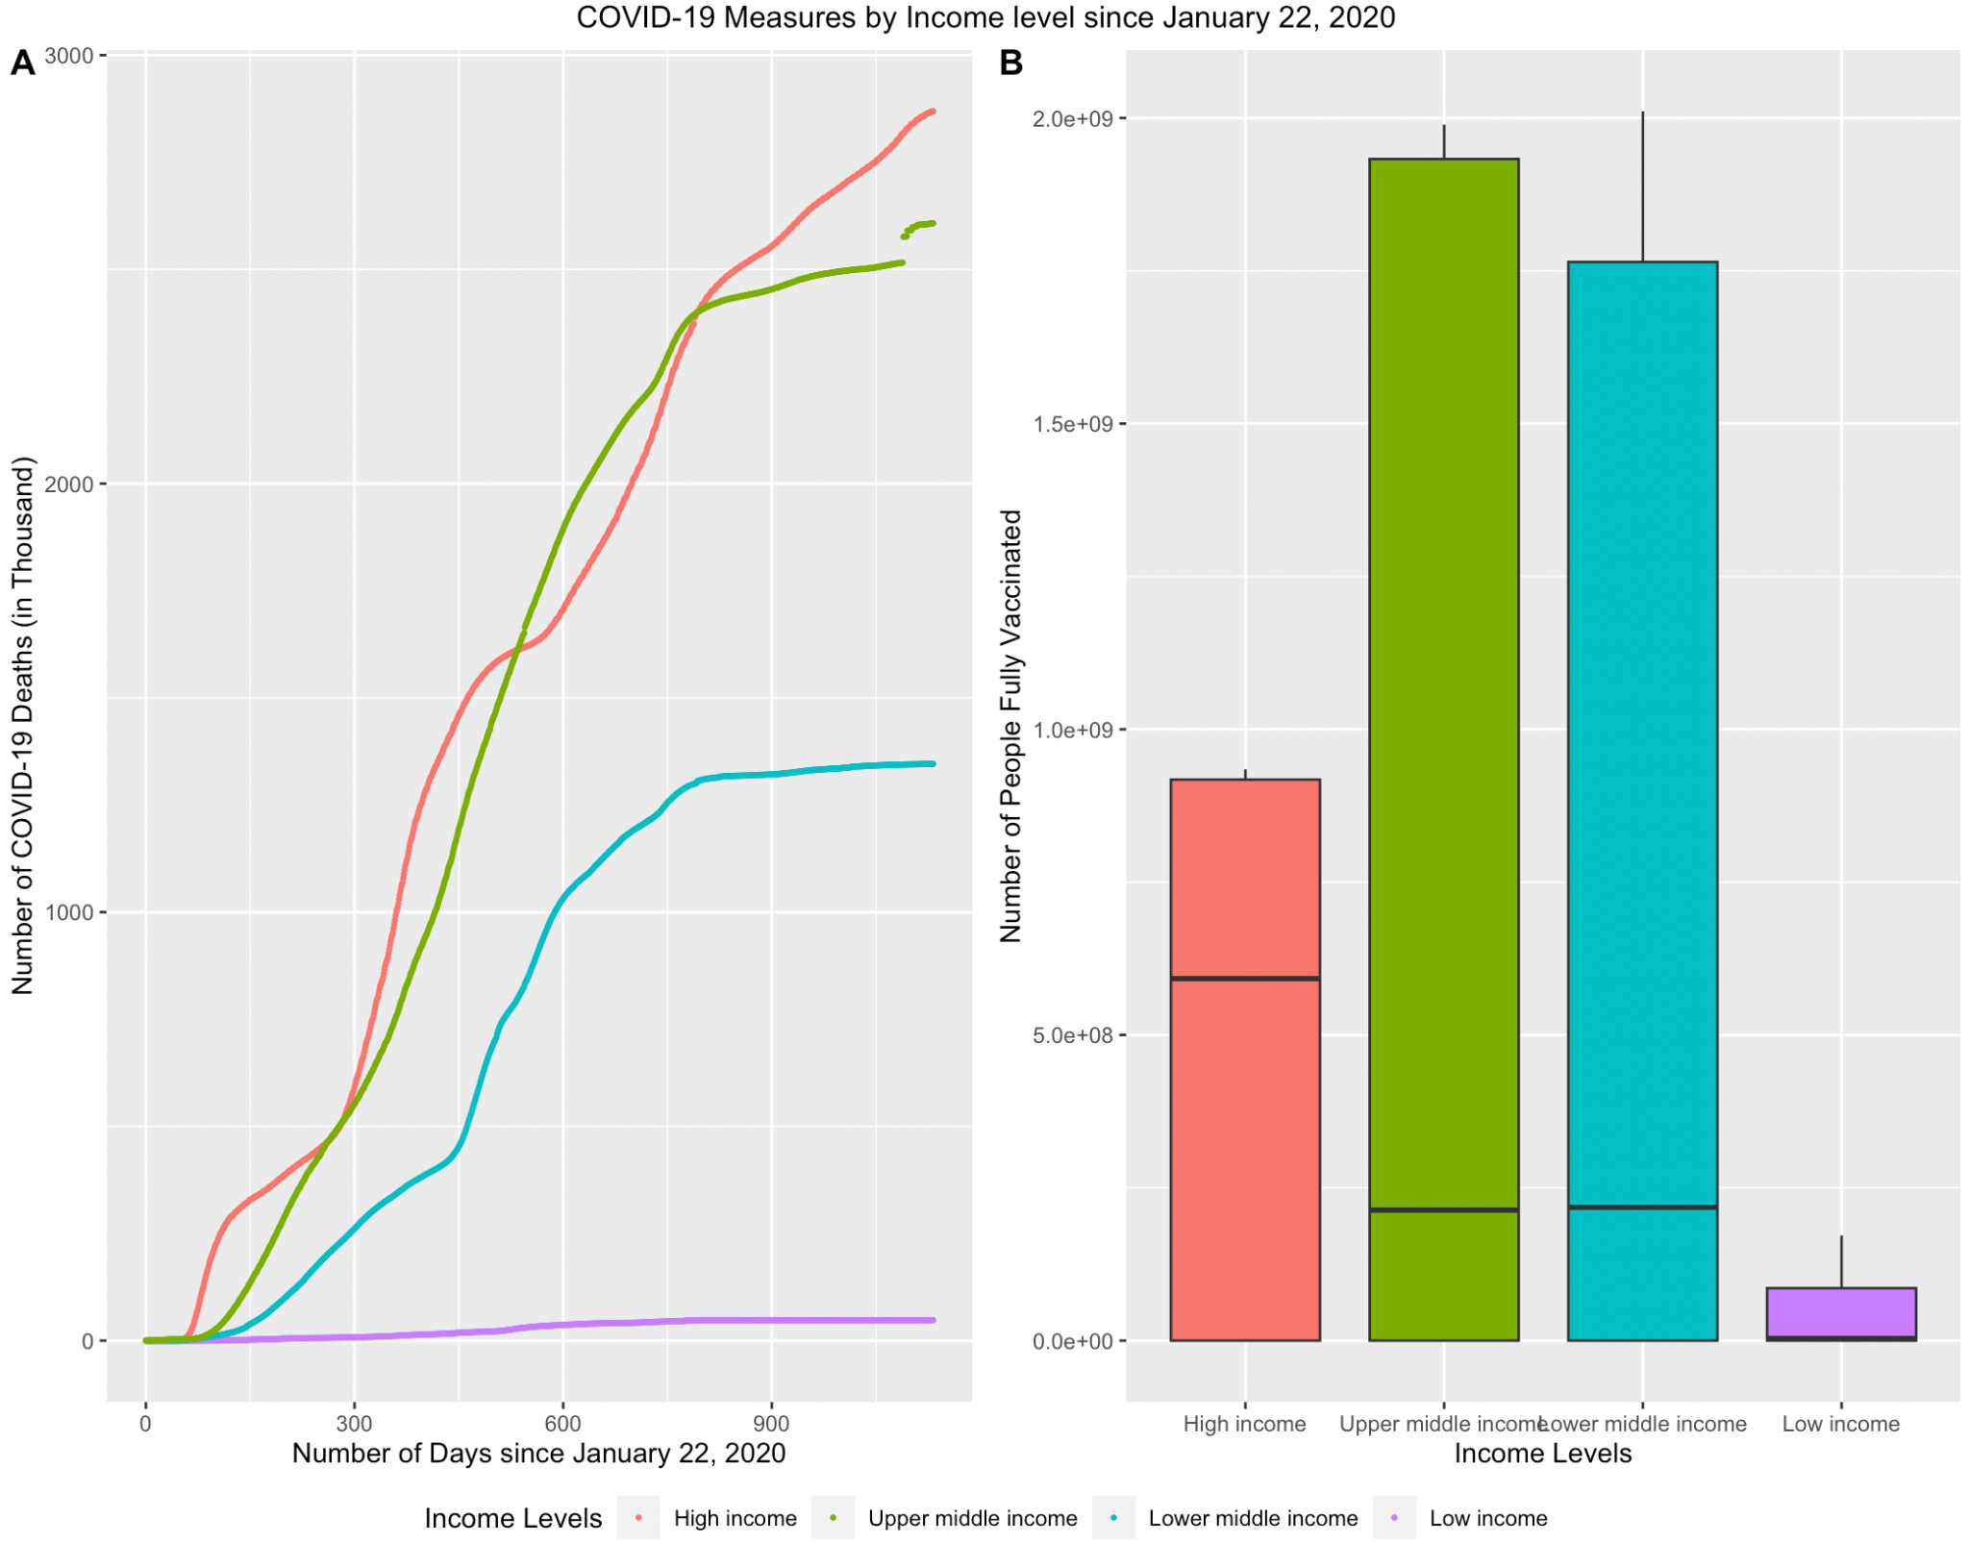
VI. Results and Findings:
Worldwide Income Level related to COVID-19 Outcomes
Graph A shows that Number of COVID-19 deaths among Income level. Higher the income is higher number of COVID-19 Deaths
Graph B shows the number of people fully vaccinated depends on the income level. Upper middle income has the highest number of people full vaccinated
Notes:
According to the World Bank, Income level is determined by Gross National Income (GNI) per capita. Low (≤$1,045), Lower-middle (>$1,045 and ≤$4,095), Upper-middle (> $ 4,095 and ≤ $12,695) and High income (> $12,695)[7]
Red color - High Income, Green - Upper middle Income, Blue - Lower middle income , Purple - Low income
Then please says the text in the slide

Slide 18
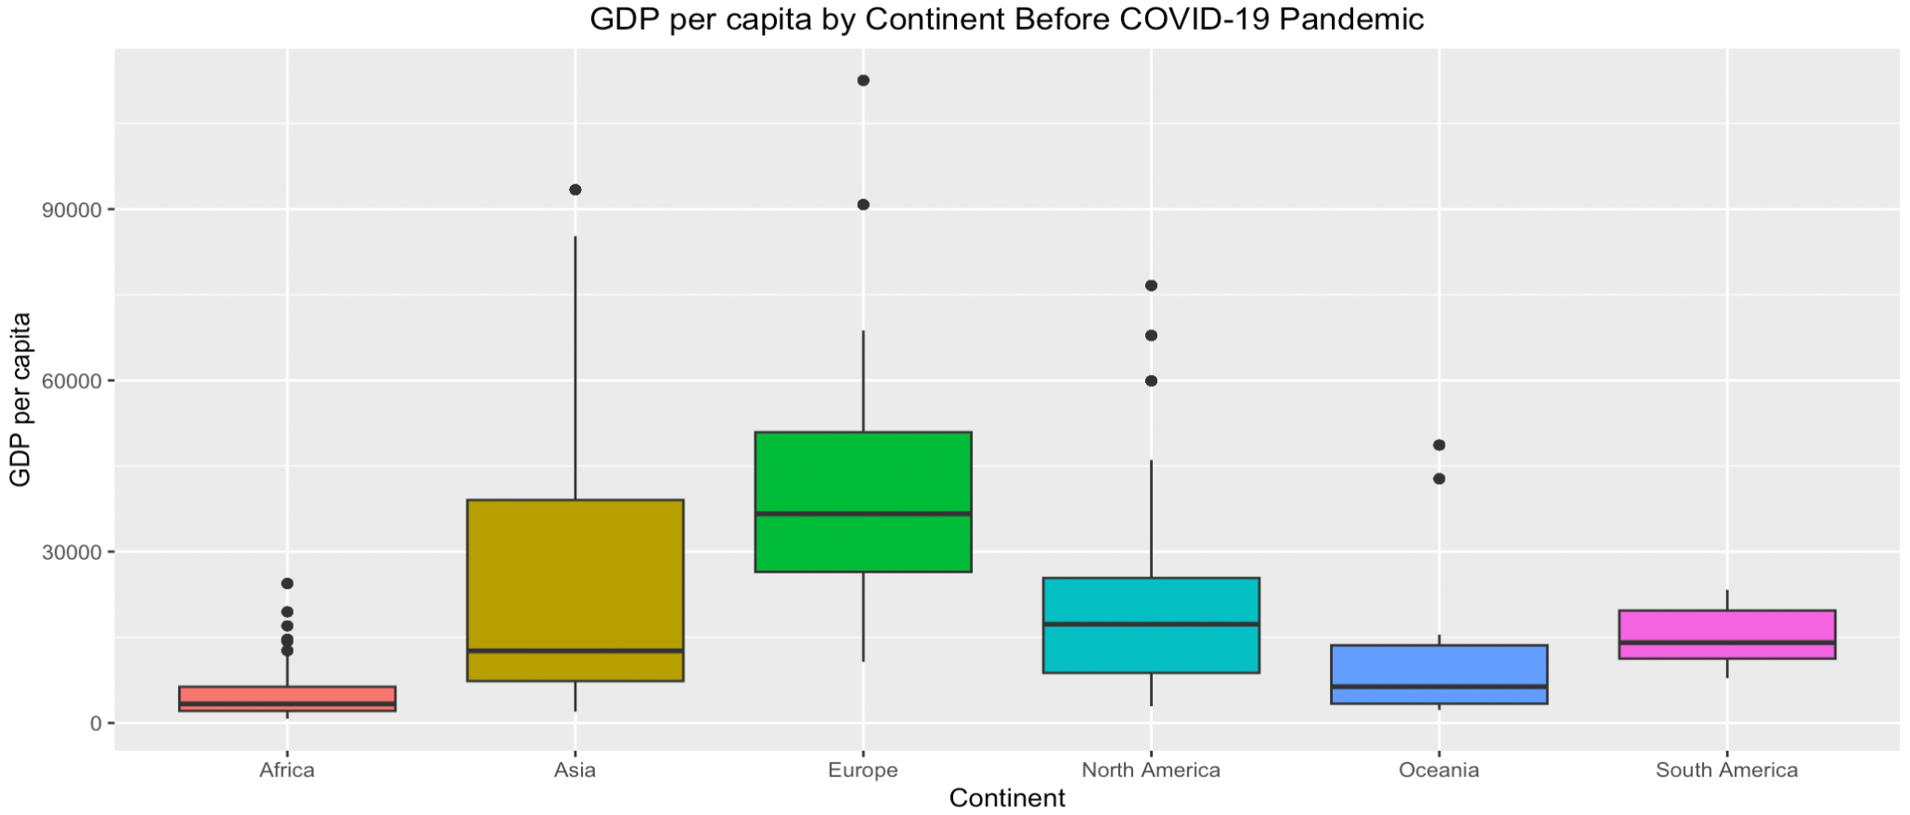
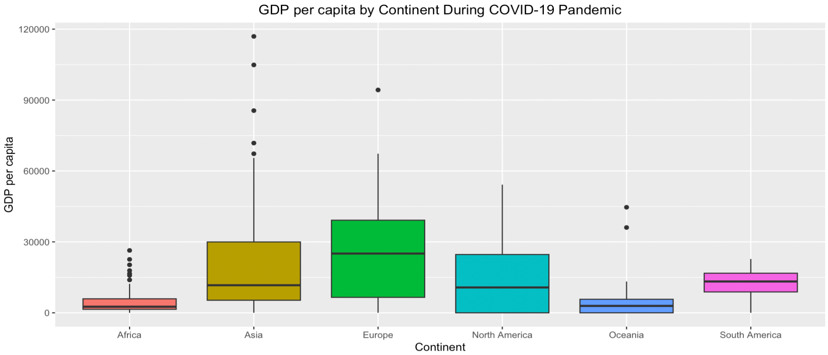
V. Data Analysis and Visualization:
Average GDP per capita by Continents and Time
Top Graph: GDP per capita before COVID-19 Pandemic (2017) by Continent
Bottom Graph: GDP per capita during COVID-19 Pandemic (2021) by Continent
Overall, median of GDP per capita was decreased during the pandemic, represented that there was global economic shrink due to the COVID-19 with restrictions on economic activities and failures in income support and consumer spending

Slide 19
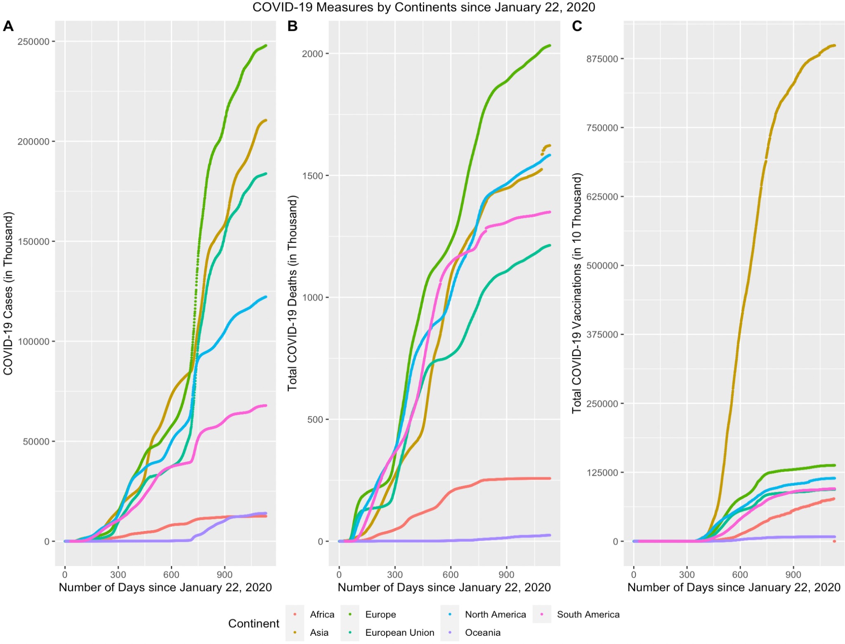
V. Data Analysis and Visualization:
COVID-19 Measurements by Continents since Jan 22, 2020
Graph A, B, and C show the Number of COVID-19 Cases, Deaths and Vaccinations, respectfully since Jan 22, 2020
Graph A and B show Europe (green) had highest number of COVID-19 cases and deaths
While Africa (pink) has low COVID-19 cases, it has high COVID-19 deaths comparing to North America (blue)
Graph C shows Asia had the most high number of Vaccinations comparing to the other continents. It shows that number of people fully vaccinated including the boosters in Asia is the higher than the other continents as the population of Asia is the largest among the continents
Notes:
Green: Europe,
Brown: Asia, Green-blue:
European Union,
Cyan/Skyblue: North America,
Pink: South America,
Red: Africa and Purple: Oceania

Slide 20
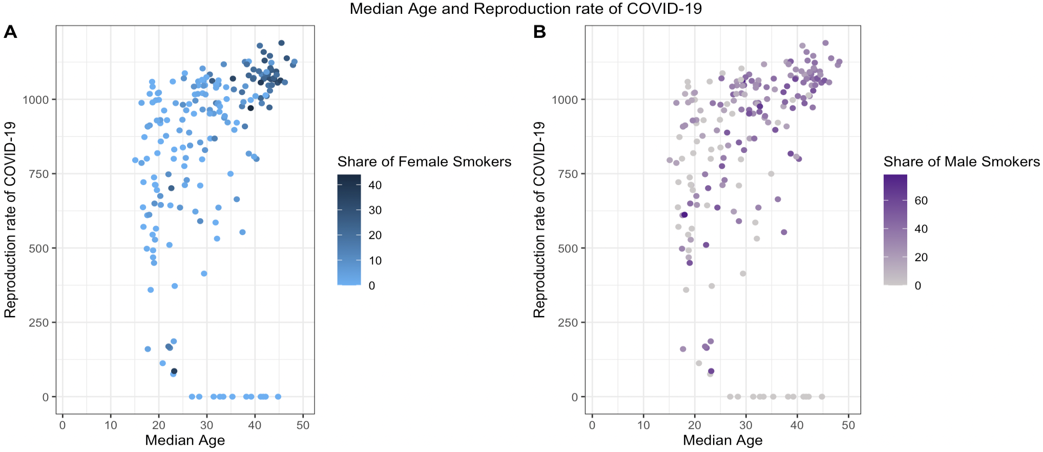
V. Data Analysis and Visualization:
Reproduction rate of COVID-19 by Median Age with the Share of Smokers
Notes:
Legend color shows the Share of Smokers by Gender. Higher share of Smokers means higher number of people are smoking.
Median Age is the median age of COVID-19 per Month
When the median Age increases, there are higher reproduction rate of COVID-19 and especially high when there are greater share of smokers.

Slide 21
VII. Conclusions
Through the COVID-19 outcomes in the USA and Worldwide relating to the Demographic and Economic factors:
There was a tendency for an increase in the number of deaths due to COVID-19 as the temperature increases, but the relationship between temperature and COVID-19 deaths was not highly correlated.
The number of deaths due to COVID-19 is higher in higher-income groups and the median GDP per capita decreased during the pandemic, indicating a global economic shrink due to restrictions on economic activities and failures in income support and consumer spending
COVID-19 deaths outnumbered deaths cause by COVID-19 with Influenza or with Pneumonia, and having Influenza and COVID-19 at the same time caused the least deaths in the USA
In the median age in higher share of smokers countries, there were higher reproduction rate of COVID-19, which implies that the COVID-19 outcomes were influenced by age and health status of the population

Slide 22

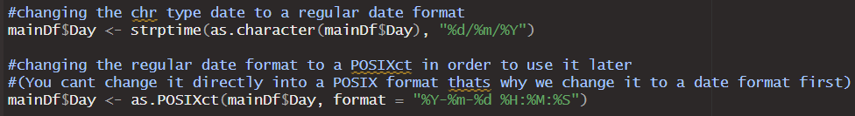
VIII. Limitations (Technical Issues between OS)
The “Day” column that shows date for that specific day is a “chr” type and also formatted in a different style than what we need
During formatting the date in the second dataset we realized when R studio opens it comes with different settings in Mac than Windows. In windows format needed to be changed 2 times in order to use it later in the code but in Mac when the document was first loaded it already comes pre formatted and ready to use.
Notes:
“Day” column here when I booted up comes as a chr type and had to be formatted 2 times in order to used in a group by but in the Mac device it already comes with the formatted version for some reason

Slide 23
VIII. Limitations and Future Steps
During the data analysis and visualization, Worldwide Low income countries or Low GDP per capita countries data were not fully updated or had limited informations within the countries such as North Korea. Thus, the datasets could not fully represented COVID-19 Cases, Deaths, and Vaccinations for those countries while High income countries or High-Mid GDP per capita countries contains very specific data points.
Some health risks such as diabetes prevalence, cardiovascular disease have same values over continents.
For the Temperature and COVID-19 cases relationship, if humidity and longitude and latitude information were provided, the relationship between climates and COVID-19 cases may show stronger correlation as survival of viruses, including human coronaviruses, is reduced when the relative humidity is in the 40–60% range

Slide 24
VIII. Limitations and Future Steps
Although many COVID-19 restrictions and measures are now released, there are still people who suffer under long COVID or Post-COVID symptoms. If we can get better demographic informations, health risks including cancer and respiratory diseases and types of variants of COVID-19, we may characterize the variants of COVID-19 and people who under going the post-COVID symptoms to develop vaccines and treatment.
If there is a datasets for COVID-19 restrictions for worldwide (there are by country in their languages), we may can predict the effective restrictions and measurements to prevent the spread of disease in the future and also investigate on differences between countries which implemented lockdown policies and others did not.
We can also visualize the COVID impact on various industries in economics way. If there is a dataset of profit of industries for each country, we could have more analysis on industries benefit from COVID (e-learning, entertainment) and which suffer the most (food services).

Slide 25
IX. References
[1] CDC Museum COVID-19 Timeline. David J. Sencer CDC Museum: In Association with the Smithsonian Institution. Retrieved from: https://www.cdc.gov/museum/timeline/covid19.html
[2] Archived: WHO Timeline - COVID-19. Retrieved from: https://www.who.int/news/item/27-04-2020-who-timeline---covid-19
[3] Edouard Mathieu, Hannah Ritchie, Lucas Rodés-Guirao, Cameron Appel, Charlie Giattino, Joe Hasell, Bobbie Macdonald, Saloni Dattani, Diana Beltekian, Esteban Ortiz-Ospina and Max Roser (2020) - "Coronavirus Pandemic (COVID-19)". Published online at OurWorldInData.org. Retrieved from: 'https://ourworldindata.org/coronavirus [Online Resource]
[4] Dong E, Du H, Gardner L. An interactive web-based dashboard to track COVID-19 in real-time. Lancet Inf Dis. 20(5):533-534. DOI: 10.1016/S1473-3099(20)30120-1
[5] National Center for Health Statistics. Provisional COVID-19 Deaths by Sex and Age. Date accessed [February 23, 2023]. Available from https://data.cdc.gov/d/9bhg-hcku.
[6] NOAA National Centers for Environmental information, Climate at a Glance: Statewide Time Series, published February 2023, retrieved on March 3, 2023 from https://www.ncei.noaa.gov/access/monitoring/climate-at-a-glance/statewide/time-series
[7] New World Bank country classifications by income level: 2022-2023. Date accessed [March 1, 2023]. Available from https://blogs.worldbank.org/opendata/new-world-bank-country-classifications-income-level-2022-2023

